Slide 1

Introduction to Statistical Techniques
Dr Lee Barnby
School of Computing
7MA505 Statistical Techniques
Week 1, Autumn Semester

Slide 2

Your Lecturer – Dr Lee Barnby
Available via email L.Barnby@derby.ac.uk
  It is best if you use your unimail address
Or send a message in the Teams chat
  We can make appointment if a longer discussion is needed
My office MS229 – planning to be on site on days with scheduled teaching, Monday, Wednesday, Thursday, Friday (WFH – Tues)
  Take the stairs from the Markeaton Street Cafe, up two floors.
  Continue straight ahead to enter the STEM extension and then turn left into a long corridor
  MS 229 is on the left, almost at the end of the corridor
  Office hour: Friday 1 – 2 pm

Slide 3
Preliminaries
Attendance
  Card reader Tap-In records attendance
  If you miss a session then you can use the attendance system to record the reason
Lecture recording
  Lectures are be recorded and will be available through the Panopto link. Therefore, your questions may be recorded.
    NB In principle in Panopto we could edit out if something we didn’t like arose in the discussion

Slide 4
Course structure
Monday Lecture 2 pm – 3 pm KR T204
  In the lecture we introduce new material as well as look at common issues which may have arisen in the tutorials
Tutorials. Please attend the one session that appears in your personal timetable from:
  Monday 4-6 or 6-8 pm in MS214/5 (rooms are joined) or Thursday 7-9 pm in MS213
Following session: some feedback (two-way) on the practical work
A module comprises 200 hours of study
Lectures and tutorials cover about 18% of this
You need to also work independently

Slide 5
Topics covered
Introduction to data analysis, R language
Statistical Inference: Point and Interval Estimation;
Hypothesis Testing; Non-Parametric Tests;
Chi-squared Test of Independence;
One-Way Analysis of Variance (ANOVA);
Correlation and Linear Regression
Logistic regression, Imputation

Slide 6
General concepts

Slide 7
Terms: populations and samples
Population
  the complete set of individuals, objects or scores of interest. Often too large to sample in its entirety. It may be real or hypothetical
    e.g. the results from an experiment repeated ad infinitum
Sample
  A subset of the population. A sample may be classified as:
    random (each member has equal chance of being selected from a population) or
    convenience (what’s available).
  Random selection attempts to ensure the sample is representative of the population.

Slide 8
Population or sample? - polls
The number of meals served by McDonalds branches each weekend in Derby
The total home attendance for each of the 20 Premier League teams in the 2018-19 season
The opening price of each of the 250 stocks in the FTSE-250 index on 1 March 2021
List of 35 houses for sale on 1 June 2021 in Derby
The ages of 50 patients enrolled in a vaccine test
Yearly expenditure on food of 1000 people contacted by telephone

Slide 9
Terms: Variable
These are the quantities measured in a sample. They may be classified as follows:
  Quantitative i.e. numerical
  Continuous E.g. pH of a sample, patient cholesterol levels
  Discrete E.g. number of bacteria colonies in a culture
  Categorical Nominal or ordinal. May also be termed qualitative
    Nominal E.g. blood group
    Ordinal ranked e.g. illness by severity, mild, moderate

Slide 10

Classification exercise
Padlet link https://derbyuni.padlet.org/l_barnby/2024-big-data-analytics-data-classification-efizbpn8sbqdvjjh
Ordinal variables can re-coded to be quantitative e.g. category, 1, 2, 3, 4 burns

Slide 11
Variable classification
Variables can be further classified as:
  Dependent/Response. Variable of primary interest (e.g. blood pressure in an anti-hypertensive drug trial) - Not controlled by the experimenter.
  Independent/Predictor called a Factor when controlled by experimenter. It is often nominal (e.g. treatment).
  Covariate when not controlled.
    If the value of a variable cannot be predicted in advance, then the variable is referred to as a random variable
  Univariate, bivariate, multivariate.

Slide 12

Dependent-Independent variables exercise
Padlet link: https://derbyuni.padlet.org/l_barnby/2024-big-data-analytics-response-predictor-variable-pairs-xbwse8lqilcn0uv9

Slide 13
Statistical Inference
Statistics: interpretation of data where random variation is present
Two possible aims
  Reaching a decision, e.g. which variety of crop gives higher yield
  Summarize information in the data. Interpretation of data, reasoning, from the particular to the general: statistical inference
Common approach: Assume the population follows a normal distribution (or binomial, or some other standard distribution). Parameters of the distribution are unknown. Hence, we must estimate these parameters.

Slide 14
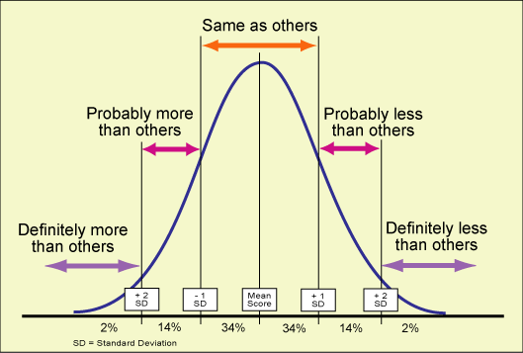
Bell Curve
less
more
less
more
-

Slide 15
Random Number Generation
Random numbers are very important for several reasons
  often, we need test data, for algorithms that are being developed. Examples of such algorithms: modelling of data; simulation studies.
  Another major application: key generation in cryptography.
  Sometimes algorithms require sampled selection of data, or of processing steps. Examples:
    the clustering algorithm known as k-means – this refers to the centres of the k clusters that it is sought to determine. This clustering approach requires k centres for the clusters to be defined in a random way, to start the algorithm. Or optimization methods using stochastic – i.e. probabilistic – algorithms.

Slide 16
Main take home message
It is worth spending time thinking about
  the nature of the data
  the problem you are trying to solve
  the statement you would like to make
And only then starting to input data and do calculations

